Slide 1
2019 Southeastern Federal Symposium
Program Overview
US Army Corps of Engineers
South Atlantic Division
5 March 2019
Mr. Al Lee
Senior Executive Service
Director of Programs

Slide 2
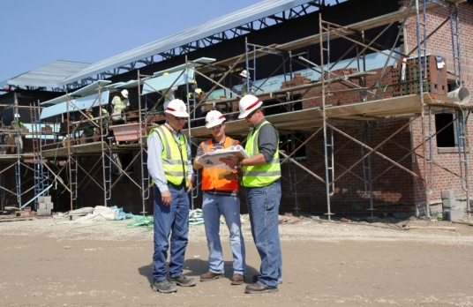
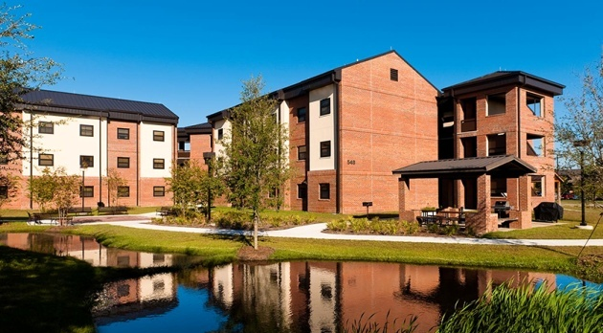
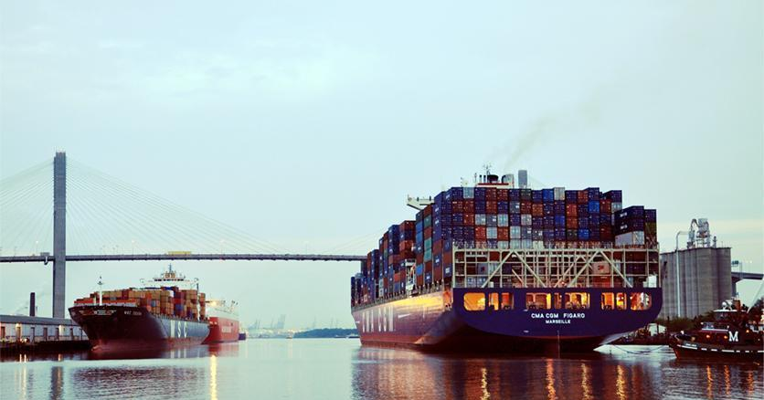
South Atlantic Division
Overview
One of nine regional business centers in USACE consisting of five districts that plan, design, build, operate and maintain military and civil works projects and facilities within the region, Central and South America, and the Caribbean.
Projects address the environmental, infrastructure, and water-resource challenges within the region
Support the military, protect America’s water resources, and restore and enhance the environment
Primary Missions:
  Civil Works
  Readiness and Contingency Operations
  Environmental
  Military
  Sustainability
Division Capabilities
Master Planning & Project Planning and Design
Construction Management Services
Engineering, Design, Management, and Inspection Services
Dredging
Operations and Maintenance (Levees; Locks; Dams; Canals; Bridges)
Contingency & Disaster Response & Recovery
Environmental Management & Services
Real Estate Services
Cost Engineering / Government Estimates
Value Engineering
Coastal Storm Damage Reduction
Modeling
Independent Technical Review
Reach-back capability to 7 USACE Research Laboratories

Slide 3
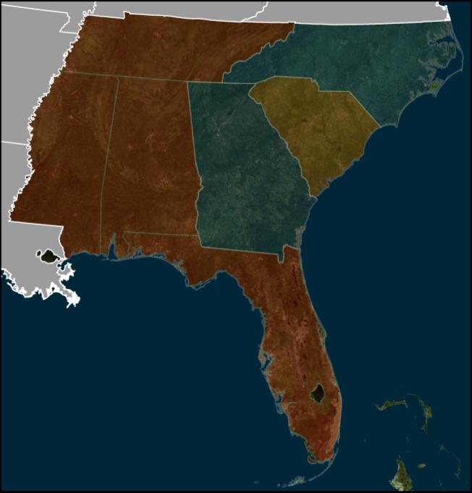
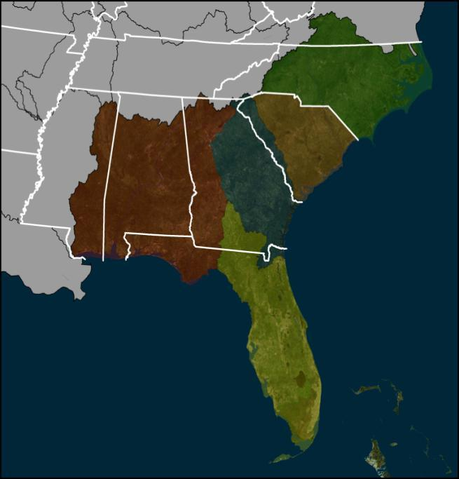


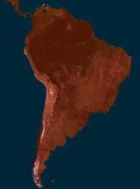
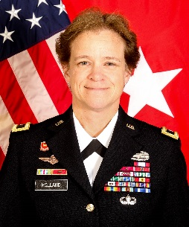
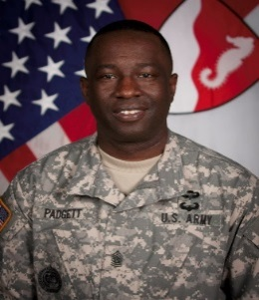
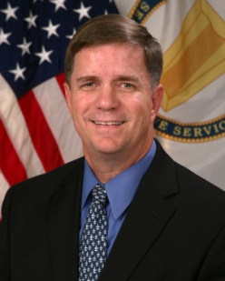
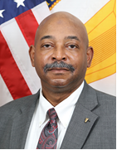
USACE South Atlantic Division (SAD)
MILITARY PROGRAM
AREAS OF RESPONSIBILITY
CIVIL WORKS
AREAS OF RESPONSIBILITY
Wilmington District
(USASOC/JSOC)
Wilmington District
SAD HQ
SAD HQ
Charleston District
Charleston District
Mobile District
Savannah District
Savannah District
Puerto Rico &
US Virgin Islands
Mobile District
Jacksonville District
Jacksonville District
MILITARY PROGRAM (MP)
14 Major Army Installations
  -Including Forts Bragg, Stewart, Benning, Gordon, Jackson, Rucker, and Redstone Arsenal
13 Major Air Force Bases
  -Including Eglin, Tyndall, MacDill, Patrick, Homestead,
  Seymour Johnson, and Maxwell Air Bases
6 Major Commands
  CENTCOM, SOUTHCOM, SOCOM,
  FORSCOM, AMC, MEDCOM
CIVIL WORKS (CW)
31 Reservoirs
1323 Miles of Levee
49 Dams Total
14 Hydropower plants
35 Deep Draft Harbors
32 Locks
Central & South America
Commander
Command Sergeant Major
Deputy Commander
Director of Programs
Director of Regional Business
BG Diana Holland
CSM Douglas Padgett
COL Patrick Hogeboom
Mr. Al Lee
Mr. Theodore Brown

Slide 4
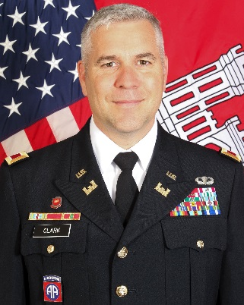
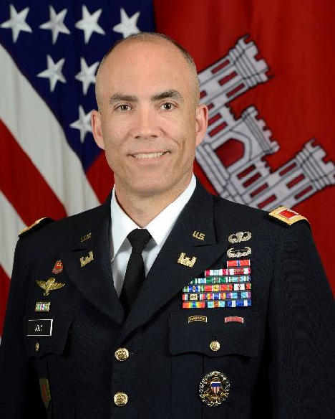
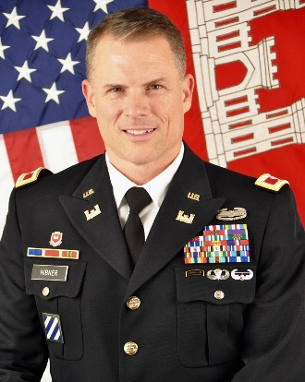
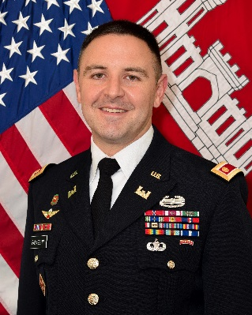
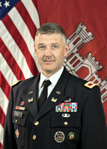
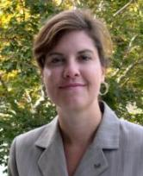
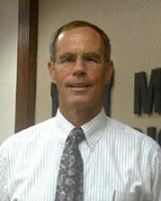
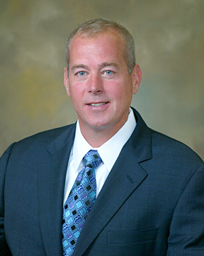
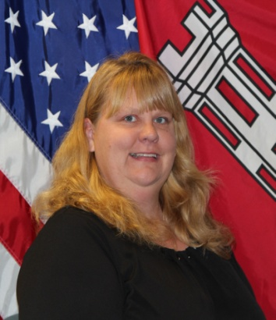
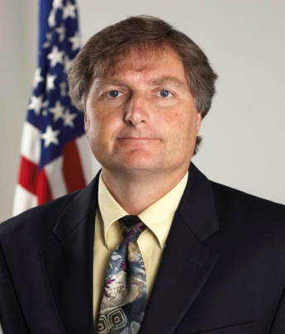
SAD District Leadership
Wilmington
District
Mobile
District
Savannah
District
Charleston
District
Jacksonville
District
Commander
Commander
Commander
Commander
Commander
COL Robert J. Clark
COL Sebastien Joly
COL Daniel Hibner
LTC Jeffrey Pallazzini
COL Andrew Kelly
DDPM
DDPM
DDPM
DDPM
DDPM
Chris Brayman, PMP
Pete Taylor, PE
Erik Blechinger, PE, PMP
Lisa Metheney
Tim Murphy, PE, PMP

Slide 5
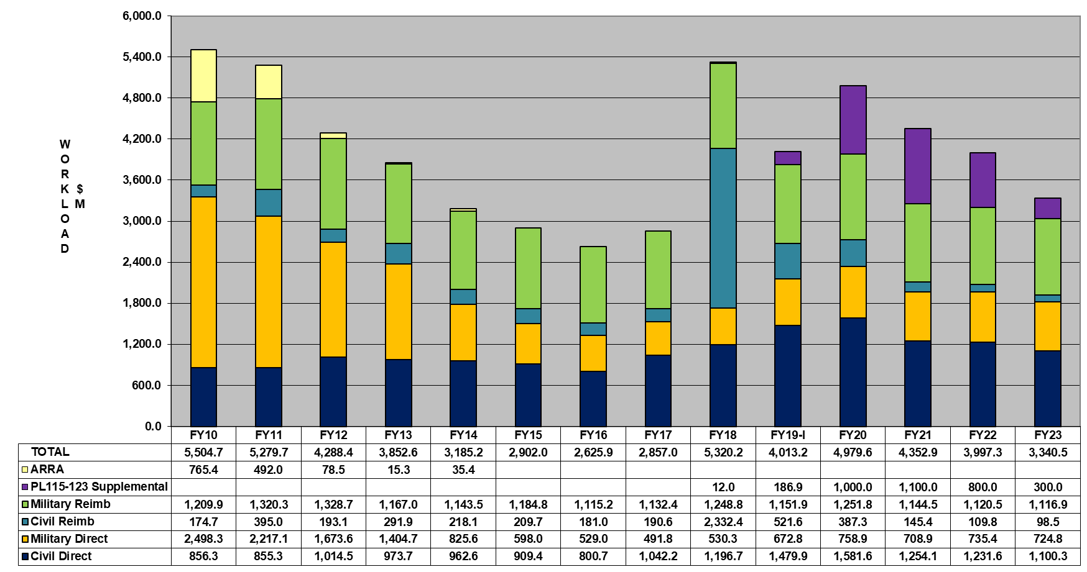

SAD Workload Trend (expenditures)

Slide 6
Charleston District Contract Opportunities FY 2019
Project | Location | Release Date | NAICS | Range | SBSA | Solicitation Type
Edisto Beach Renourishment | Colleton County, SC | 2nd Qtr FY19 | 237990 | $10-$15M | TBD | TBD
Charleston Harbor South Jetty Repair | Charleston County, SC | 2nd Qtr FY19 | 237990 | TBD | TBD | IFB
Lower Harbor O&M Dredging | Charleston County , SC | 1st Qtr FY19 | 237990 | $5-$10M | UNRESTRICTED | IFB
DDRT FIS Contract FY 19-21 | Red River Army Depot, Texarkanna, TX | 1st Qtr FY19 | 561210 | $1-$5M | SBSA | RFP
Construction MATOC – East (MFR, DLA, etc) | Multiple Locations | 1st Qtr FY 19 | 236220 | $40-$50M | TBD | RFP
Construction MATOC – West (MFR, DLA, etc) | Multiple Locations | 1st Qtr FY 19 | 236220 | $40-$50M | TBD | RFP
Program will become more defined as customers determine projects they can fund in FY 19.
Notes:
Types of work that will be available:
BUFFALO DISTRICT: Breakwater repairs, a dike repair, a pump station, and a harbor deepening.
CHICAGO DISTRICT: 2 dredging projects and 2 jobs for pier work.
DETROIT DISTRICT: 10 contracts for dredging, 3 for contaminated sediment capping, and 1 to replace gates and seals at the Kaukaune Dam on the Fox River in Wisconsin.
HUNTINGTON DISTRICT: From replacing handrails at Dover Dam and shoreline erosion repair at Greenup Dam to installing solar panels at Grayson Lake and replacing sheaves on an emergency gate at Winfield Locks and Dam.
LOUISVILLE DISTRICT: 5 contracts at Ft. Campbell, Kentucky, ranging from a multi-use helicopter training facility to an elementary school; 3 at Wright-Patterson Air Force Base; and various others, to include: building a dining facility, an Army Reserve Center, a new VA Medical facility, and an indoor small arms range.
NASHVILLE DISTRICT: 5 in heavy construction, 3 in power & communication & related structures construction, and 2 in plumbing, heating and a/c related projects.
PITTSBURGH DISTRICT: 2 streambank restoration projects, work on 2 dam repairs, and concrete repairs at 2 lock locations.

Slide 7
Charleston District Contract Opportunities FY 2019
Project | Location | Release Date | NAICS | Range | SBSA | Solicitation Type
Columbia VAMC Medical Clinic Construction | Columbia, SC | 2nd Qtr FY19 | 236220 | $5-$10M | SDVOSB | RFP
Columbia VAMC Prosthetics & Sensory Aid Center | Columbia, SC | 1st Qtr FY19 | 236220 | $5-$10M | SDVOSB | RFP
Columbia VAMC Behavioral Health Center of Excellence | Columbia, SC | 1st Qtr FY19 | 236220 | $5-$10M | SDVOSB | RFP
Columbia VAMC Center for Rehabilitative Services | Columbia, SC | 1st Qtr FY19 | 236220 | $5-$10M | SDVOSB | RFP
Survey Vessel EVANS Annual Shipyard Maintenance Services | Charleston SC | 1st Qtr FY19 | 336611 | $125K | SBSA | RFP
** 81st RSC 2 Municipal Services Contracts and 3 Facility Investment Services Contracts – total $30 – 40M
** VA – Fort Jackson Cemetery value TBD
Notes:
Types of work that will be available:
BUFFALO DISTRICT: Breakwater repairs, a dike repair, a pump station, and a harbor deepening.
CHICAGO DISTRICT: 2 dredging projects and 2 jobs for pier work.
DETROIT DISTRICT: 10 contracts for dredging, 3 for contaminated sediment capping, and 1 to replace gates and seals at the Kaukaune Dam on the Fox River in Wisconsin.
HUNTINGTON DISTRICT: From replacing handrails at Dover Dam and shoreline erosion repair at Greenup Dam to installing solar panels at Grayson Lake and replacing sheaves on an emergency gate at Winfield Locks and Dam.
LOUISVILLE DISTRICT: 5 contracts at Ft. Campbell, Kentucky, ranging from a multi-use helicopter training facility to an elementary school; 3 at Wright-Patterson Air Force Base; and various others, to include: building a dining facility, an Army Reserve Center, a new VA Medical facility, and an indoor small arms range.
NASHVILLE DISTRICT: 5 in heavy construction, 3 in power & communication & related structures construction, and 2 in plumbing, heating and a/c related projects.
PITTSBURGH DISTRICT: 2 streambank restoration projects, work on 2 dam repairs, and concrete repairs at 2 lock locations.

Slide 8



For More Information
www.sac.usace.army.mil
(Business With Us menu)
twitter.com/CharlestonCorps
www.facebook.com/CharlestonCorps

Slide 9
Wilmington District Contract Opportunities
Military Program Awards in FY19-20
Project # | Location | Project Title | Value | ACQ Strategy | ADV
91252 | Ft. Bragg | SOF, Pedestrian Bridge | $1M-$5M | RFP/SB | Apr 2019
80774 | Ft. Bragg | Sere Resistance Training Lab Complex | $10M-$25M | RFP/TBD | Apr 2019
82254 | Ft. Bragg | SOF, Dining Facility | $5M-$10M | RFP/UR | May 2019
89057 | Ft. Bragg | SOF, Dining Facility | $10M-$25M | RFP/TBD | Aug 2019
87539 | Ft. Bragg | SOF, Operations Facility | $5M-$10M | RFP/TBD | Oct 2019
92594 | Ft. Bragg | SOF, Operations Support Facility | $25M-$100M | RFP/UR | Oct 2019

Slide 10
Wilmington District Contract Opportunities
Military Program Awards in FY19-20
Project # | Location | Project Title | Value | ACQ Strategy | ADV
81165 | Ft. Bragg | SOF, Human Performance Training Facility | $25M-$100M | RFP/UR | Oct 2019
86021 | Ft. Bragg | SOF, Assessment and Selection Training Complex | $10M-$25M | RFP/TBD | Jan 2020
87437 | Ft. Bragg | SOF, Group Headquarters | $25M-$100M | RFP/UR | Sep 2020
 | Ft. Bragg MOTSU | SRM, Ft. Bragg/MOTSU | $1M-$5M | TBD/TBD | 3rd/4th Qtr FY 19
 | MOTSU | SATER, IDIQ | $>10M | 8A Competitive | March 2019
 | MOTSU | Portable Water Line Improvement | $1M-$5M | TBD/SB | June 2019
 | MOTSU | Fire Fighting Water Pressure Improvement | $1M-$5M | TBD/SB | June 2019

Slide 11
Wilmington District Contract Opportunities
FY 19 Civil Works Projects
Location | Project Title | Value | ACQ Strategy | ADV
Wilmington, NC | Eagle Island Improvements Cells 1 & 2 | $1M-$5M | IFB/SB | Feb 2019
Concord, NC | Concord Stream Restoration | $1M-$5M | RFP/SB | Feb 2019
Wilkesboro, NC | W.K.Scott O&M | $1M-$5M | RFP/8A Competitive | Mar 2019
Patrick County, VA | South Mayo Creek Flood Reduction Project Rehabilitation | $500K-$1M | IFB/SB | Apr 2019
Ocean Isle Beach, NC | Ocean Isle Beach Rock Removal | $250K-$500K | RFP/SB | Apr 2019
Boydton, VA | J.H. Kerr Floating Bulkhead | $1M-$5M | TBD/SB | Apr 2019
Bassett, VA | Philpott O&M | $1M-$5M | RFP/8A Competitive | Apr 2019
Bassett, VA | Philpott Landslide Repair | $250K-$500K | TBD/SB | May 2019

Slide 12
Wilmington District Contract Opportunities
FY 19 Civil Works Projects
Location | Project Title | Value | ACQ Strategy | ADV
Wilmington, NC | Wilmington Harbor Mid River/MOTSU Dredging | $10M-$25M | IFB/UR | May 2019
Morehead City, NC | Morehead City Inner Harbor Dredging | $1M-$5M | IFB/SB | May 2019
Dare County, NC | Manteo-Rollison-Silver Lake Harbor-Water Way to Sound Dredging | $1M-$5M | IFB/SB | Jun 2019
Patrick County, VA | South Mayo Creek Flood Reduction Project Rehabilitation | $500K-$1M | IFB/SB | Apr 2019
 | AIWW Maintenance Dredging | $5M-$10M | IFB/SB | May 2019
Morehead City, NC | Morehead City Cutoff Range A/ Range B Ocean Bar Dredging | $5M-$10M | IFB/UR | May 2019
Wilmington, NC | Eagle Island Improvements Cells 2, Toe Berm Spillway Repair | $1M-$5M | IFB/SB | Jun 2019
Savannah, GA Wilmington, NC | Regional Hopper Dredge Contract, | $>20M | IFB/UR | Jul 2019

Slide 13
Wilmington District Contract Opportunities
FY 19 Civil Works Projects
Location | Project Title | Value | ACQ Strategy | ADV
Wilmington, NC | Wilmington Harbor Anchorage Basin Dredging | $1M-$5M | IFB/SB | Jul 2019
NC | Hurricane Matthew Inland Repairs | $1M-$5M | IFB/SB | Jul 2019

Slide 14
Wilmington District Contract Opportunities
FY 19 Anticipated Architecture and Engineering Awards
Location | Project Title | Value | ACQ Strategy | ADV
Wilmington District AOR | Environmental IDIQ Contract | $>10M | RFP/8A Competitive | Mar 2019
Wilmington District | Vertical A&E Contract | $10M-$25M | RFP/UR | Jul 2019

Slide 15
For More Information
Contracting Department
U.S. Army Corps of Engineers
Wilmington District
69 Darlington Avenue
Wilmington, NC 28403
910-251-4884
Small Business Office at (910) 251-4452

Slide 16
Savannah District Contract Opportunities: Standalone
 | CIVIL WORKS PROGRAM
PROPONENT ORGANIZATION | CONTRACT | MAGNITUDE OF CONSTRUCTION | BUSINESS STANDARD | SCOPE | ADVERTISE
Operations Division | Savannah Inner Harbor Maintenance Dredging | $25-$100M | UR | Maintenance Dredging NAICS 237990 | 4rd Qtr FY19
Operations Division | Brunswick Inner Harbor Maintenance Dredging | $1M - $5M | SB | Maintenance Dredging NAICS 237990 | 4th Qtr FY19
Civil Works Project Management | SHEP Inner Harbor Dredging Reaches A & B | $100-250M | UR | New Work Dredging NAICS 237990 | 3rd Qtr FY19
Civil Works Project Management | SHEP Inner Harbor Dredging Reaches C, D & E | $100-250M | UR | New Work Dredging NAICS 237990 | 3rd Qtr FY19
Spencer Davis, Chief, Civil Works Programs & Project Management Branch
spencer.w.davis@usace.army.mil (912) 652-5195
Notes:
Updated 17 Oct 2018 by Spencer Davis for CW PM
Updated 17 Oct 2018 by Roger Lafond and Katie Kuehn for OP

Slide 17
Savannah District Contract Opportunities: Standalone
 | MILITARY CONSTRUCTION PROGRAM
PROPONENT ORGANIZATION | CONTRACT | MAGNITUDE OF CONSTRUCTION | BUSINESS STANDARD | ACQUISITION | ADVERTISE
Military Programs | SCI Training, Research, & Network Center, Ft. Gordon, GA | $75M - $100M | UR | Design Bid Build “C” Type LPTA | 2nd Qtr FY19
Military Programs | Moran Hall South Renovation, Ft. Gordon, GA | $20M - $30M | UR | Design Bid Build “C” Type LPTA | 2nd Qtr FY19
Military Programs | Bldg 399 Renovation Ft. Benning, GA | $25M - $50M | UR | Design Bid Build “C” Type LPTA | 2nd Qtr FY19
Military Programs | Custer Road Repair, Ft. Benning, GA | $25M - $50M | UR | Design Bid Build “C” Type LPTA | 2nd Qtr FY19
Military Programs | Upgrade Chiller Plant Ft. Bragg, NC | $1M - $5M | SB | Design Bid Build IFB | 3rd Qtr FY19
Anthony Cady, Chief, Military Programs & Project Management Branch
anthony.e.cady@usace.army.mil (912) 652-5642
Notes:
Updated 16 Jan 2019 by Tony Cady

Slide 18
Savannah District Contract Opportunities: Standalone
 | MILITARY CONSTRUCTION PROGRAM
PROPONENT ORGANIZATION | CONTRACT | MAGNITUDE OF CONSTRUCTION | BUSINESS STANDARD | ACQUISITION | ADVERTISE
Military Programs | GO/CSM Family Housing, Ft. Gordon, GA | $5M - $10M | SB | Design Bid Build IFB | 3rd Qtr FY19
Military Programs | Tng Barracks Upgrade, Ft. Gordon, GA | $20M - $30M | UR | Design Build | 3rd Qtr FY19
Military Programs | SATCOM RLBs Ft. Gordon, GA | $10M - $20M | SB | Design Build | 3rd Qtr FY19
Military Programs | Supply Support Activity Warehouse Ft. Stewart, GA | $1M - $5M | SB | Design Bid Build IFB | 3rd Qtr FY19
Military Programs | Phase III GSHP, Ft. Bragg, NC | $1M - $5M | SB | Design Bid Build IFB | 3rd Qtr FY19
Anthony Cady, Chief, Military Programs & Project Management Branch
anthony.e.cady@usace.army.mil (912) 652-5642
Notes:
Updated 16 Jan 2019 by Tony Cady

Slide 19
Savannah District Contract Opportunities: Standalone
 | MILITARY CONSTRUCTION PROGRAM
PROPONENT ORGANIZATION | CONTRACT | MAGNITUDE OF CONSTRUCTION | BUSINESS STANDARD | ACQUISITION | ADVERTISE
Military Programs | Bldg 17 Renovation, Ft. Benning, GA | $5M - $10M | SB | Design Bid Build “C”’ Type LPTA | 3rd Qtr FY19
Military Programs | Replace Ramey Elementary School Puerto Rico | $50M - $75M | UR | Design Bid Build “C” Type LPTA | 4th Qtr FY19
Military Programs | Personnel Recovery Hangar Moody AFB, GA | $25M - $50M | UR | Design Bid Build “C”’ Type LPTA | 4th Qtr FY19
Military Programs | SCI Mission Command, University Registrar, Force Mod Facility Ft. Gordon, GA | $75M - $100M | UR | Design Bid Build “C” Type LPTA | 2nd Qtr FY20
Anthony Cady, Chief, Military Programs & Project Management Branch
anthony.e.cady@usace.army.mil (912) 652-5642
Notes:
Updated 16 Jan 2019 by Tony Cady

Slide 20
Savannah District
Contract Opportunities: IDIQ
 | A/E CONTRACTS
PROPONENT ORGANIZATION | CONTRACT | CONTRACT CAPACITY | BUSINESS STANDARD | SCOPE | ADVERTISE
Engineering Division | General Design (MILCON) | 3 @ $20M | UR | Preparation of reports, studies, master planning, project planning, design criteria, preparation of drawings and specifications, commissioning, cost estimates, and other general A-E services for multi-disciplined projects. POP 5 years. | 3 in 1st Qtr FY20
Engineering Division | General Design (CIVIL WORKS) | 2 @ $15M | UR | Preparation of reports, studies, master planning, project planning, design criteria, preparation of drawings and specifications, commissioning, cost estimates, and other general A-E services for multi-disciplined projects. POP 5 years. | 1st Qtr FY19
Engineering Division | Construction Management Services | 2 @ $15M | UR | Furnish the required personnel, equipment, instruments, and transportation, as necessary to accomplish the required services and furnish to the Government reports and other data together with supporting material developed during the period of service, 5 years. | 1st Qtr FY20
 |  | 2 @ $8M | SB
Anthony Cady, Chief, Military Programs & Project Management Branch
anthony.e.cady@usace.army.mil (912) 652-5642
Notes:
Updated June 13, 2018, by: Eng: Sam Hong (New POC is Megan Williams and Steve Bath)
Confirmed by Jennifer Murphy Mason 21 June 18

Slide 21
Savannah District
Contract Opportunities: IDIQ
 | MILITARY PROGRAMS
PROPONENT ORGANIZATION | CONTRACT | CONTRACT CAPACITY | BUSINESS SIZE | SCOPE | ADVERTISE
Military Programs | NC MATOC | $75M | SB | Design/Build General Construction NAICS Code: 236220 POP 5 Years Area of Coverage SAS AOR | Phase 1 Under Evaluation Advertise Phase 2 2nd Qtr 2018
Military Programs | GA/SC MATOC | $249M | UR | Design/Build General Construction NAICS Code: 236220 POP 5 Years Area of Coverage SAS AOR | Phase 2 Advertised 11 Dec 2018
Military Programs | East Georgia SATOC | $45M | SB | Design/Build General Construction NAICS Code: 236220 POP 5 Years Area of Coverage SAD | Phase 2 Advertised 16 Jan 2019
Anthony Cady, Chief, Military Programs & Project Management Branch
anthony.e.cady@usace.army.mil (912) 652-5642
Notes:
Updated 16 Jan 2019 by Tony Cady
Confirmed by Jennifer Murphy-Mason 21 June 18

Slide 22
Savannah District
Contract Opportunities: IDIQ
 | MILITARY PROGRAMS
PROPONENT ORGANIZATION | CONTRACT | CONTRACT CAPACITY | BUSINESS SIZE | SCOPE | ADVERTISE
Military Programs | Benning SATOC | $95M | 8(a) | Design/Build General Construction NAICS Code: 236220 POP 5 Years Area of Coverage SAD | Phase 1 2nd Qtr FY19
Military Programs | Benning SATOC | $49M | SDVOSB | Design/Build General Construction NAICS Code: 236220 POP 5 Years Area of Coverage SAD | Phase 1 2nd Qtr FY19
Military Programs | Bragg Roofing SATOC | $49M | HZ | Roofing Construction / Repair NAICS Code: 238160 POP 5 Years Area of Coverage SAD | Phase 1 3rd Qtr FY19
Anthony Cady, Chief, Military Programs & Project Management Branch
anthony.e.cady@usace.army.mil (912) 652-5642
Notes:
Updated 16 Jan 2019 by Tony Cady
Confirmed by Jennifer Murphy-Mason 21 June 18

Slide 23
Savannah District
Hurricane Response
CIVIL WORKS PROGRAM
PROPONENT ORGANIZATION | CONTRACT | MAGNITUDE OF CONSTRUCTION | BUSINESS STANDARD | ACQUISITION | ADVERTISE
Operations | Savannah National Wildlife Refuge Water Control Structure Repair | $1M - $5M | SB | Existing IDIQ Contract | 2nd Qtr FY19
Operations | Depot Boat Ramp & Fixed Dock Repair | $1M - $5M | SB | Existing IDIQ Contract | 2nd Qtr FY19
Operations | Jones Oyster Bed Island Dredged Material Containment Area Repair | $10M - $25M | SB | IFB | 2nd Qtr FY19
Notes:
Created and update by Jason Okane (OP) Jan. 18, 2019
Updated by Katie Kuehn 18 Oct 2018

Slide 24
For More Information
CESAS-CT.SAS@usace.army.mil
(Business With Us menu)
Leila Hollis
Contact: SB Office 912-652-5340 CESAS-SB.SAS@usace.army.mil

Slide 25
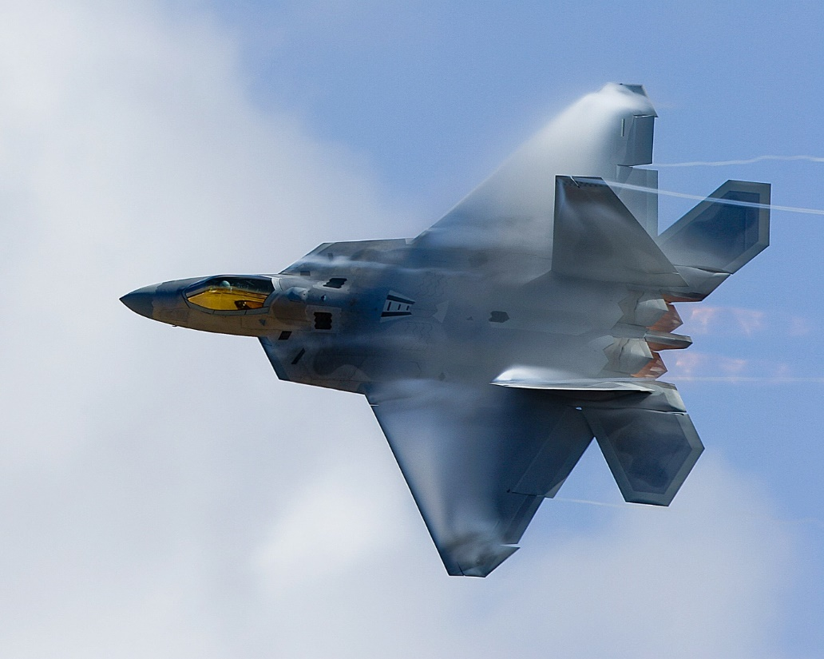
TYNDALL AFB Response & Recovery
AF Initial Response
  -TF Phoenix
  -AFCAP
USACE Support:
  -Initial Bldg Assessments
  -Temp Roofing
  -TF Hammer
  -AE TOs for D-B Repairs
  -Modular Buildings
  -FEST Team Deployment
Long Term Recovery

Slide 26
A-E Brooks Acts Opportunities –
NAICS 541330
Mobile District FY 2019
Project | Set-Aside Category | Est. Award Value | Projected Advertise Date
AE Services Environmental HTRW & EQ (Interim REAT Replacements) | HTRW - $45M UR, $4M SBSA EQ – $45M UR, $4M SBSA | $49M HTRW $49M EQ | W91278-18-R-0093 closes 14 Mar 2019 - EQ
AE Services Engineering & Environmental Military & Civil (REAT Replacement - Compliance & HTRW) | $210M UR $40M SBSA | $250M | 3d Qtr, FY19
AE Services Planning & Environmental Division Military & Civil Works (REAT Replacement - NEPA/Master Planning) | $210M UR $40M SBSA | $250M | 3d Qtr, FY19
AE Services Military Design | TBD | $99M | 3d Qtr, FY19
Notes:
First two procurements - AE services for Planning/Engineering Environmental will be replacement contracts for current REAT. Area of responsibility will be Mobile District vice current contracts for SAD AOR. Other districts in SAD may borrow capacity.
Last two procurements are interim REATs. First to advertise will be Planning Environmental.

Slide 27
A-E Brooks Acts SATOC Opportunities – NAICS 541330
Mobile District FY 2019
Project | Set-Aside Category | Est. Award Value | Projected Advertise Date
AE Horizontal Civil Geotechnical MILCON | $6.9M UR $3M SBSA | $9.9M | Apr 2019
MEDCOM AE | TBD | $49M | 1st Qtr, FY20
AE Services – Design of Consolidated Test Center, Redstone Arsenal (SATOC) | UR – Stand Alone “C” Contract | $49M | Re-Advertise Mar-April 2019
Notes:
Future date to advertise AE Military Design solicitation will rely on remaining capacity which will be reviewed after 1 Oct 2018.

Slide 28
Construction
NAICS 236220 (unless otherwise noted)
Project | Set-Aside Category | Est. Award Value | Projected Advertise Date
MEDCOM Western Region 2 Phase D-B MATOC | UR SBSA | $249M | 1st Qtr, FY20
Military Construction North/South Regions Mobile District AOR 2 Phase D-B MATOCs | $245M (2) UR $200M (2) SBSA | $845M | W91278-18-R-0001& 0002 UR Closes 5 Mar 2019 W91278-18-R-0003 & 0004 SBSA 4th Qtr FY 19 Advertise
Air Traffic Control Tower Maxwell AFB, AL D-B-B “C” Type Contract | UR or SB | <$20M | 3d Qtr, FY19

Slide 29
Construction Continued
Project | Set-Aside Category | Est. Award Value | Projected Advertise Date
Aircraft Maint Hangar Soto Cano, Honduras D-B-B “C” type contract | UR | >$20M | 1st Qtr, FY20
Maint Facility (TEMF) Soto Cano, Honduras D-B-B “C” type contract | UR | >$10M | 1st Qtr, FY20
Fire Station Tyndall AFB, FL D-B “C” type contract | SBSA | <$20M | 3d Qtr, FY19 W91278-18-R-0082
Training Support Facility Ft. Rucker, AL D-B-B “C” type contract | UR | <$50M | 3d Qtr, FY19
Alterations to PEO STRI Building, Orlando, FL D-B-B “C” type contract | UR | <$20M | W91278-19-R-0004 Advertised 22 Feb 2019

Slide 30
Construction Continued
Project | Set-Aside Category | Est. Award Value | Projected Advertise Date
F35A ITCA Eglin AFB, FL D-B-B “C” type contract | UR | <$50M | 2d Qtr, FY19 W91278-19-R-0014 closes 28 Feb 2019.
Replace Dorm 19 Eglin AFB, FL D-B-B “C” type contract | UR | <$50M | 2d Qtr, FY19
Long Range Standoff Facility Eglin AFB, FL D-B “C” type contract | UR | <$50M | 3d Qtr, FY19
Maint Training Facility Hurlburt Field, FL D-B-B “C” type contract | UR or SB | <$20M | 3d Qtr, FY19
Combat Parking Apron Hurlburt Field, FL D-B-B “C” type contract | UR | <$50M | 3d Qtr, FY19

Slide 31
Construction Continued
Project | Set-Aside Category | Est. Award Value | Projected Advertise Date
MSCIP Barrier Islands Phases III/IV (Dredging) (NAICS 237990) IFB | UR | >$50M | 2d Qtr, FY20
Vertical Construction MATOC To support Operations Division Projects | Hubzone | $1.9m | 1 Mar 2019
Horizontal Construction MATOC To support Operations Division Projects NAICS -237990 | WOSB | $1.9m | 1 Mar 2019
Notes:
Dredging has different NAICS from vertical construction.

Slide 32
For More Information
Linda.L.Spadaro@usace.army.mil
Office of Small Business Programs, Mobile District
251-690-3597
www.sam.usace.army.mil

Slide 33





Mobile District Contacts
Internet and Social Media
Phone & Mailing Address
sam.usace.army.mil
Public Affairs Office (General Information)
(251) 690-2505
U.S. Army Corps of Engineers
Mobile District
P.O. Box 2288
Mobile, AL 36628-0001
facebook.com/usacemobile
twitter.com/usacemobile
Instagram.com/usacemobile
flickr.com/photos/usacemobile

Slide 34
Jacksonville District FY2019 & Beyond Contracting Opportunities
Fiscal Year | Project Title | Project Location | Projected Advertise Date | Type Work | Estimated Award | Set-Aside Category | Procurement Method
2020 | Jax Harbor Deepening Contract C | Duval County,FL | May 2020 | DREDGING 237990 | $180,000,000 -$225,000,000 | UNR | RFP
2021 | Jax Harbor Deepening Contract D | Duval County,FL | May 2021 | DREDGING 237990 | $100,000,000 - $150,000,000 | UNR | RFP
2019 | O&M Dredging Kings Bay Entrance | Nassau County, FL | Jun 2019 | DREDGING 237990 | $15,000,000 - $25,000,000 | UNR | IFB
2020 | O&M Dredging Kings Bay Inner Channel | Camden County, FL | Nov 2019 | DREDGING 237990 | $10,000,000 - $15,000,000 | SB | IFB
2019 | Palm Beach Harbor, Jetty Repairs | Volusia County, FL | May 2019 | Heavy Civil Works & Construction 237990 | $1,000,000 - $5,000,000 | TBD Based on Market Research | TBD
View all of Jacksonville District Contracting Opportunities at:
www.saj.usace.army.mil/Business-With-Us/Small-Business/

Slide 35
Jacksonville District FY2019 & Beyond Contracting Opportunities
Fiscal Year | Project Title | Project Location | Projected Advertise Date | Type Work | Estimated Award | Set-Aside Category | Procurement Method
2019 | Brevard County, Mid & South Reaches CSRM (FCCE SUPP) Hopper & Truck Haul | Brevard County, FL | May 2019 | DREDGING 237990 | $25,000,000 - $50,000,000 | UNR | RFP
2019 | St Lucie South Segment CSRM (SUPP) | St. Lucie County, FL | May 2019 | DREDGING 237990 | $10,000,000 – $25,000,00 | UNR | IFB
2019 | O&M Dredging Palm Beach Harbor | Palm Beach County, FL | Jul 2019 | DREDGING 237990 | $1,000,000 – $5,000,000 | UNR | IFB
2020 | Palm Beach County CSRM (FCCE SUPP) Delray Beach | Palm Beach County, FL | Oct 2019 | DREDGING 237990 | $5,000,000 – $10,000,00 | UNR | IFB
2020 | Palm Beach County CSRM (FCCE SUPP) Jupiter Carlin | Palm Beach County, FL | Oct 2019 | DREDGING 237990 | $10,000,000 – $25,000,00 | UNR | IFB
2020 | Palm Beach County CSRM (FCCE SUPP) Boca Raton | Palm Beach County, FL | Jul 2020 | DREDGING 237990 | $10,000,000 - $25,000,000 | UNR | IFB
View all of Jacksonville District Contracting Opportunities at:
www.saj.usace.army.mil/Business-With-Us/Small-Business/

Slide 36
Jacksonville District FY2019 & Beyond Contracting Opportunities
Fiscal Year | Project Title | Project Location | Projected Advertise Date | Type Work | Estimated Award | Set-Aside Category | Procurement Method
2020 | Palm Beach County CSRM (FCCE SUPP) Ocean Ridge | Palm Beach County, FL | Jul 2020 | DREDGING 237990 | $5,000,000 - $10,000,000 | UNR | IFB
2020 | Flagler County CSRM (SUPP) | Flagler County, FL | Feb 2020 | DREDGING 237990 | $10,000,000 - $25,000,000 | UNR | IFB
2020 | St Johns County CSRM (SUPP) Vilano Segment | St. Johns County, FL | Jan 2020 | DREDGING 237990 | $25,000,000- $50,000,000 | UNR | IFB
2020 | Port Everglades Nav. Improvements Deepening & Widening | Broward County, FL | Dec 2019 | DREDGING 237990 | $300,000,000 - $400,000,000 | UNR | RFP
2019 | O&M Dredging Port Everglades Harbor | Broward County, FL | Jul 2019 | DREDGING 237990 | $5,000,000 - $10,000,000 | UNR | IFB
View all of Jacksonville District Contracting Opportunities at:
www.saj.usace.army.mil/Business-With-Us/Small-Business/

Slide 37
Jacksonville District FY2019 & Beyond Contracting Opportunities
Fiscal Year | Project Title | Project Location | Projected Advertise Date | Type Work | Estimated Award | Set-Aside Category | Procurement Method
2020 | O&M Dredging Miami Harbor | Dade County, FL | Aug 2019 | DREDGING 237990 | $5,000,000 - $10,000,000 | UNR | IFB
2019 | C-44 Intake Canal Bank Stabilization Project using geotextile and rip-rap | Martin County, FL | Mar 2019 | Heavy Civil Works Construction 237990 | $15,000,000 - $25,000,000 | UNR | RFP
2019 | USMC Blount Island Concrete Sill Removal | Duval County, FL | Apr 2019 | CIVIL CONST 237990 | $10,000,000 - $25,000,00 | TBD Based on Market Research | RFP
2019 | IWW/OWW Construction of DMMA 023 | Martin County, FL | May 2019 | CIVIL CONST 237990 | $5,000,000 - $10,000,000 | TBD Based on market research | RFP
2020 | Big Fishwear Creek Aquatic Eco System Restoration Project | Duval County, FL | Mar 2020 | CIVIL CONST 237990 | $1,000,000 – $5,000,000 | TBD | TBD
2019 | C&SF Upper St. John River Basin – S252s Rehabilitation Slip Lining | Indian River County | May 2019 | Heavy Civil Works Construction 237990 | $1,000,000 - $5,000,000 | SBSA | RFP
View all of Jacksonville District Contracting Opportunities at:
www.saj.usace.army.mil/Business-With-Us/Small-Business/

Slide 38
Jacksonville District FY2019 & Beyond Contracting Opportunities
Fiscal Year | Project Title | Project Location | Projected Advertise Date | Type Work | Estimated Award | Set-Aside Category | Procurement Method
2019 | O&M Dredging St Matanzas | St Johns County, FL | Mar 2019 | DREDGING 237990 | $1,000,000 - $5,000,00 | SB | IFB
2019 | O&M Dredging IWW Jupiter/Crosswards/OWW R3 | Martin County, FL | May 2019 | DREDGING 237990 | $1,000,000 - $5,000,00 | SB | IFB
2019 | O&M Dredging Anclote River | Pinellas/Pasco Counties, FL | Feb/Mar 2019 | DREDGING 237990 | $1,000,000 - $5,000,00 | SB | IFB
2019 | O&M Dredging Gulf Intracoastal Waterway (GIWW) (SUPP) | Venice Inlet & GIWW Sarasota County, FL | Jun2019 | DREDGING 237990 | $1,000,000 - $5,000,00 | SB | IFB
2019 | Biscayne Bay Coastal Wetlands Phase 1 Project, L-31 Flow away Pump Station S209 and Culverts S-706 A, B, C, andS-708 CNT 4 | Miami Dade County | May/Jun 2019 | Heavy Civil Works Construction 237990 | $5,000,000 - $10,000,000 | TBD Based on market research | RFP
2019 | Lee County CSRM (SUPP) | Gasparilla Island, FL | Nov 2018 | DREDGING 237990 | $5,000,000 - $10,000,00 | UNR | IFB
View all of Jacksonville District Contracting Opportunities at:
www.saj.usace.army.mil/Business-With-Us/Small-Business/

Slide 39
Jacksonville District FY2019 & Beyond Contracting Opportunities
Fiscal Year | Project Title | Project Location | Projected Advertise Date | Type Work | Estimated Award | Set-Aside Category | Procurement Method
2019 | Manatee County CSRM (SUPP) | Anna Maria Island, FL | Jan 2019 | DREDGING 237990 | $10,000,000 - $25,000,000 | UNR | IFB
2019 | O&M Dredging Manatee Harbor | Manatee County, FL | Jul 2019 | DREDGING 237990 | $1,000,000 - $5,000,000 | SB | IFB
2019 | O&M Dredging Naples to Gordon Pass (Big Marco) | Naples, Collier County, FL | Postponed Indefinitley | DREDGING 237990 | $1,000,000 - $5,000,000 | SB | IFB
2019 | Manatee Harbor DMMA Offloading | Manatee County | Feb 2019 | CIVIL CONST | $1,000,000 - $5,000,000 | SB | IFB
2019 | Lido Key Beach CSRM (SUPP) And Groin Construction | Lido Key, Sarasota County, FL | May 2019 | DREDGING 237990 | $10,000,000 - $25,000,000 | TBD | IFB
2019 | O&M Dredging Suwannee River (SUPP) | Dixie County, FL | Jul 2019 | DREDGING 237990 | $1,000,000 - $5,000,000 | SB | IFB
View all of Jacksonville District Contracting Opportunities at:
www.saj.usace.army.mil/Business-With-Us/Small-Business/

Slide 40
Jacksonville District FY2019 & Beyond Contracting Opportunities
Fiscal Year | Project Title | Project Location | Projected Advertise Date | Type Work | Estimated Award | Set-Aside Category | Procurement Method
2019 | O&M Dredging Arecibo Harbor | Arecibo, PR | Jul 2019 | DREDGING 237990 | $5,000,000- $10,000,000 | UNR | IFB
2019 | O&M Dredging Mayaguez Harbor (SUPP) | Mayaguez, PR | Jul 2019 | DREDGING 237990 | $5,000,000- $10,000,000 | UNR | IFB
2019 | O&M Maintenance Dredging MATOC | South Atlantic Division | Aug 2018 | DREDGING 237990 | NTE $450,000,000 | UNR | RFP W912EP18R0029 Under Eval
2019 | O&M Maintenance Dredging MATOC | South Atlantic Division | Aug 2018 | DREDGING 237990 | NTE $45,000,000 | SB | RFP W912EP18R0029 Under Eval
View all of Jacksonville District Contracting Opportunities at:
www.saj.usace.army.mil/Business-With-Us/Small-Business/

Slide 41
Jacksonville District FY2019 & Beyond Contracting Opportunities
Fiscal Year | Project Title | Project Location | Projected Advertise Date | Type Work | Estimated Award | Set-Aside Category | Procurement Method
2019 | Water Control Structure Culvert Replacement HHD (HP-5) | Palm Beach, Glades, Hendry Counties, FL | Nov 2018 | CIVIL CONST 237990 | $10,000,000 - $25,000,000 | UNR | RFP
2019 | HHD Cut Off Wall Task Order #1 | Lake Harbor, FL | Dec 2018 | CIVIL CONST 237990 | $100,000,000 - $125,000,000 | UNR | RFP- HHD Cut Off Wall MATOC
2019 | HHD Cut Off Wall Task Order #2 | Clewiston, FL | Jan 2019 | CIVIL CONST 237990 | $100,000,000 - $125,000,000 | UNR | RFP- HHD Cut Off Wall MATOC
2019 | HHD Cut Off Wall Task Order #3 | Moore-Haven, FL | Apr 2019 | CIVIL CONST 237990 | $75,000,000- $100,000,000 | UNR | RFP- HHD Cut Off Wall MATOC
2019 | HHD Cut Off Wall Task Order #4 | Moore-Haven, FL | Sep 2019 | CIVIL CONST 237990 | $50,000,000 - $75,000,000 | UNR | RFP- HHD Cut Off Wall MATOC
2019 | HHD SR78 Bridge Armoring | Herbert Hoover Dike Area | Oct 2019 | CIVIL CONST 237990 | $1,000,000 - $5,000,000 | SB Program TBD | TBD
View all of Jacksonville District Contracting Opportunities at:
www.saj.usace.army.mil/Business-With-Us/Small-Business/

Slide 42
Jacksonville District FY2019 & Beyond Contracting Opportunities
Fiscal Year | Project Title | Project Location | Projected Advertise Date | Type Work | Estimated Award | Set-Aside Category | Procurement Method
2020 | HHD Cut Off Wall Task Order #5 | Lakeport, FL | Jan 2020 | CIVIL CONST 237990 | $50,000,000 - $75,000,000 | UNR | RFP- HHD Cut Off Wall MATOC
2019 | C-44 Intake Canal Bank Stabalization Project Using Geotextile and Rip-Rap | Martin County, FL | Mar 2019 | CIVIL CONST 237990 | $15,000,000 - $25,000,000 | UNR | RFP
2019 | CAP Section 14 Emergency Streambank & Shoreline Protection, Salud Creek San German | San German, Puerto Rico | Jul 2019 | CIVIL CONST 237990 | $1,000,000 - $2,000,000 | TBD | RFP
2019 | CAP Section 14, Emergency Streambank & Shoreline Protection, Mount Sinai Medical Center | Dade County, FL | Jul 2019 | CIVIL CONST 237990 | $5,000,000- $10,000,000 | TBD | RFP
2019 | CAP Section 14 Emergency Streambank & Shoreline Protection, Loiza, PR | Loiza, Puerto Rico | Jul 2019 | CIVIL CONST 237990 | $1,000,000 - $5,000,000 | TBD | RFP
View all of Jacksonville District Contracting Opportunities at:
www.saj.usace.army.mil/Business-With-Us/Small-Business/

Slide 43
Jacksonville District FY2019 & Beyond Contracting Opportunities
Fiscal Year | Project Title | Project Location | Projected Advertise Date | Type Work | Estimated Award | Set-Aside Category | Procurement Method
2019 | HHD Bridge Repairs –Road Removal –Picayune Strand | Collier County, FL | TBD | CIVIL CONST 237990 Subject to Change | $5,000,000 - $10,000,000 | TBD | TBD
2019 | Broward County Shore Protection CSRM (SUPP) Segment II Truck Haul | Broward County, FL | Jun 2019 | CIVIL CONST 237990 | $5,000,000 - $10,000,000 | TBD | IFB
2020 | Broward County Shore Protection CSRM (SUPP) Segment III Truck Haul & Hopper | Broward County, FL | Jun 2020 | DREDGING 237990 | $50,000,000 - $75,000,000 | UNR | IFB
2019 | Dade County CSRM (SUPP) Surfside Truck Haul Contract A | Miami-Dade County, FL | Feb 2019 | CIVIL CONST 237990 | $25,000,000 - $50,000,000 | UNR | IFB
2019 | Dade County CSRM (SUPP) Truck Haul Hotspots Contract B | Miami-Dade County, FL | Apr 2019 | CIVIL CONST 237990 | $25,000,000 - $50,000,000 | TBD | IFB
2020 | Dade County CSRM (SUPP) Bal Harbour –Contract C | Miami-Dade County, FL | Dec 2019 | CIVIL CONST 237990 | $15,000,000 - $25,000,000 | TBD | IFB
2020 | Dade County CSRM (SUPP) Miami Beach & Sunny Isles Contract D | Miami-Dade County, FL | Jun 2020 | CIVIL CONST 237990 | $50,000,000 - $100,000,000 | TBD | IFB
View all of Jacksonville District Contracting Opportunities at:
www.saj.usace.army.mil/Business-With-Us/Small-Business

Slide 44
Jacksonville District FY2019 & Beyond Contracting Opportunities
Fiscal Year | Project Title | Project Location | Projected Advertise Date | Type Work | Estimated Award | Set-Aside Category | Procurement Method
TBD | USCG Station Fort Lauderdale PROVISIONAL Relocation Housing & Operations | Broward County, FL | TBD | Lessors of Residential Buildings & Dwellings 531110 |  | TBD Based on market research | RFP
TBD | USCG Station Fort Lauderdale Reconfiguration of Housing & Operations | Broward County, FL | TBD | Commercial & Building Const 236220 | $30,000,000 - $50,000,000 | TBD Based on market research | RFP
TBD | Cano Martin Pena – Contract 1 Staging Area Ciudad Deportiva Roberto Clemente (CDRC) includes bulkhead, boat ramp, clearing & grubbing | Puerto Rico | TBD | CIVIL CONST 237990 | $1,000,000- $5,000,000 | TBD | TBD Highly contingent on funding
2019 | Manatee Protection System, Maintenance & Repairs, Upgrades to the (6) Manatee Protection Systems (MPS) at Lock and Dam facilities within the USACE Jacksonville District. | Canaveral Lock, St. Lucie Lock, Port Mayaca Lock, Moore Haven Lock, Ortona Lock and W.P. Franklin Lock FL | March 2019 | 561990 All Other Support Services |  | TBD Based on Market Research | RFP
View all of Jacksonville District Contracting Opportunities at:
www.saj.usace.army.mil/Business-With-Us/Small-Business

Slide 45
Jacksonville District FY2019 & Beyond Contracting Opportunities
Fiscal Year | Project Title | Project Location | Projected Advertise Date | Type Work | Estimated Award | Set-Aside Category | Procurement Method
2019 | Project Delivery Process (PDP) Support Svcs SATOC or BPA | Jacksonville District AOR | Mar 2019 | SERVICES | EST $7,000,000 | SB Program | GSA Professional SVCS 871-OOCORP
2019 | IDIQ Geotechnical Core Drilling & Laboratory | Puerto Rico, U.S. Virgin Islands, and Caribbean | Mar 2019 | AE Services 541330 | IDT Contract Base w/4 options. One contract w/total capacity $5mil | SBSA | Brooks Act
2019 | IDIQ Geotechnical Core Drilling & Laboratory | Jacksonville District AOR | Apr 2019 | AE Services 541330 | IDT Contract Base w/4 options. One contract w/total capacity $9mil | SBSA | Brooks Act
2020 | Topographic Only Surveying | Florida | 3rd/4th QTR 2019 | AE Surveying & Mapping Services 541370 | IDT Contract Base w/4 options. Up to 2 contracts valued at $5mil each | SB Program TBD | Brooks Act
2021 | Remote Sensing | FL, PR & US Virgin Islands | 3rdQTR 2020 | AE Surveying & Mapping Services 541370 | IDT Contract Base w/4 options. Up to 2 contracts valued at $5mil each | SB Program TBD | Brooks Act
View all of Jacksonville District Contracting Opportunities at:
www.saj.usace.army.mil/Business-With-Us/Small-Business

Slide 46
Jacksonville District FY2019 & Beyond Contracting Opportunities
Fiscal Year | Project Title | Project Location | Projected Advertise Date | Type Work | Estimated Award | Set-Aside Category | Procurement Method
2022 | Topographic/Hydrographic Surveying | Florida | 3rdQTR 2021 | AE Surveying & Mapping Services 541370 | IDT Contract Base w/4 options. Up to 5 contracts valued at $5mil each | SB Program TBD | Brooks Act
2022 | Topographic Only Surveying | Puerto Rico & US Virgin Islands | 3rdQTR 2022 | AE Surveying & Mapping Services 541370 | IDT Contract Base w/4 options. Up to 2 contracts valued at $5mil each | SB Program TBD | Brooks Act
View all of Jacksonville District Contracting Opportunities at:
www.saj.usace.army.mil/Business-With-Us/Small-Business

Slide 47
Jacksonville District FY2019 & Beyond Contracting Opportunities
Fiscal Year | Project Title | Project Location | Projected Advertise Date | Type Work | Estimated Award | Set-Aside Category | Procurement Method
2020 | Rio Puerto Nuevo and tributaries (multiple projects) | San Juan, PR | TBD | CIVIL CONST 237990 | $800 Million – $1 Billion (total of all projects) | TBD Based on Market Research | RFP
2020 | Rio Grande de Arecibo |  | TBD | CIVIL CONST 237990 | $50 Million - $100 Million | TBD Based on Market Research | RFP
2020 | Rio Grande de Loiza |  | TBD | CIVIL CONST 237990 | $150 Million - $300 Million | TBD Based on Market Research | RFP
2020 | Rio Guanajibo at Mayaguez |  | TBD | CIVIL CONST 237990 | $50 Million – $75 Million | TBD Based on Market Research | RFP
2020 | Rio Nigua at Salinas |  | TBD | CIVIL CONST 237990 | $50 Million – $75 Million | TBD Based on Market Research | RFP
View all of Jacksonville District Contracting Opportunities at:
www.saj.usace.army.mil/Business-With-Us/Small-Business/

Slide 48
For More Information
View all of Jacksonville District Contracting Opportunities at:
www.saj.usace.army.mil/Business-With-Us/Small-Business

