Slide 1

Centers for Disease Control and Prevention (CDC) Overview
Dale DeFilipps
Branch Chief, Office of Acquisition Services
Office of Financial Resources
Society of American Military Engineers (SAME)
2019 Southeastern Federal Symposium
Office of the Director
Office of Financial Resources (OFR)

Slide 2
CDC Overview

Slide 3
CDC Mission
To promote health and quality of life by preventing and controlling disease, injury, and disability

Slide 4
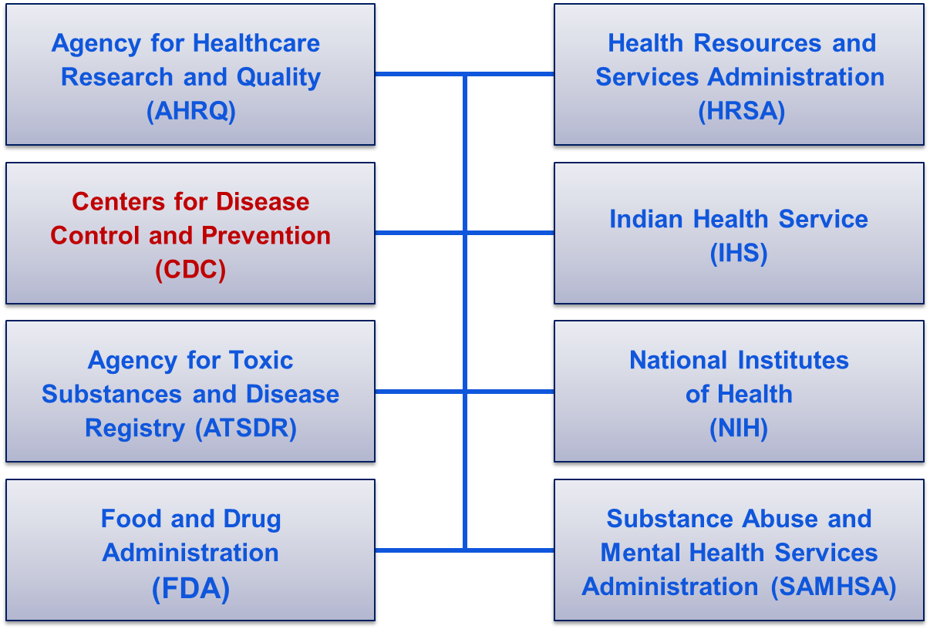
Department of Health and Human Services

Slide 5
CDC Major Program Areas
Chronic Diseases
Environmental Health
Infectious Diseases
Injury Prevention and Control
Birth Defects
Emergency Preparedness
Occupational Safety and Health
Health Statistics

Slide 6

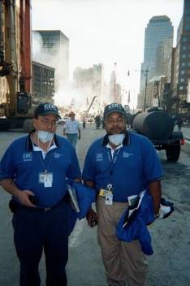

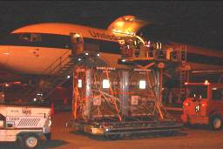
CDC’s Unique Capabilities
Epidemiology and surveillance
Vaccines
Laboratory sciences
Public health expertise
Strategic National Stockpile
Select Agent Program
Quarantine and community mitigation
Public health preparedness and state readiness

Slide 7
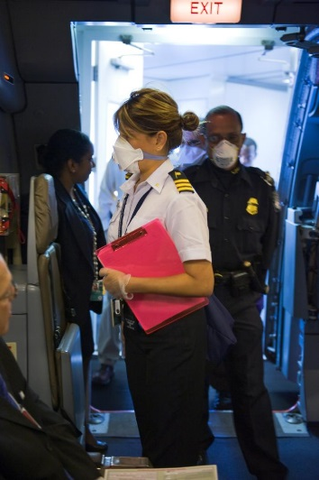
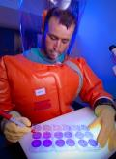
CDC Fast Facts: Our Employees
◽ Over 11,000 Government Employees
◽ 8,500 Georgia Employees
◽ Over 5,000 Contract Staff
◽ CDC listed as one of the Best Places to Work in
the Federal Government
◽ One of the top employers in Atlanta and the
State of Georgia
◽ About 70% of employees have college degrees
◽ Almost 50% of employees have advanced degrees
◽ 170 occupational categories
◽ The average age is 45

Slide 8
CDC Employees and Locations
Spokane
Seattle
San
Francisco
Chicago
Pittsburgh
Hyattsville
Washington
DC Area
Ft Collins
Denver
Cincinnati
Morgantown
Research
Triangle
Atlanta
Anchorage
San Juan
Miami

Slide 9

CDC International Locations
Angola
Bangladesh
Botswana
Brazil
Burkina Faso
Cambodia
Cameroon
China
Congo
Congo DRC
Cote D’Ivoire
Denmark
Egypt
Ethiopia
France
Ghana
Lesotho
Madagascar
Malawi
Mali
Mozambique
Namibia
Nepal
Nigeria
Peru
Philippines
Russia
Rwanda
Senegal
South Africa
Swaziland
Sweden
Sudan
Switzerland
Tanzania
Thailand
Trinidad
Uganda
United Kingdom
Uzbekistan
Vietnam
Zambia
Zimbabwe
Guatemala
Guyana
Haiti
India
Indonesia
Jordan
Kazakhstan
Kenya
Laos
Countries with CDC Staff

Slide 10
CDC Business Overview

Slide 11
Office of Financial Resources Consolidated
Spending History
(Billions)

Slide 12
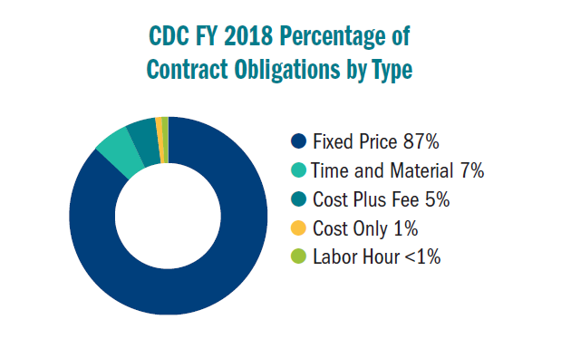
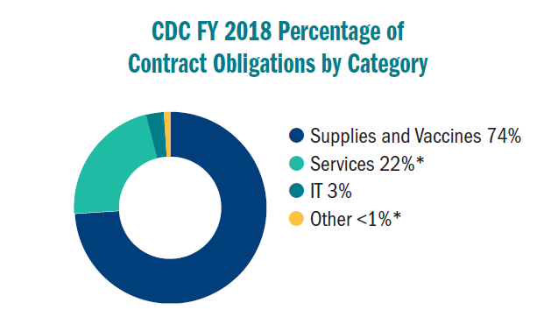
CDC Spend FY 2018 Statistics
Procurement
Fixed Price 87%
Time and Material 7%
Cost Plus Fee 5%
Cost Only 1%
Labor Hour < 1%
Supplies and Vaccines 74%
Services 22%*
IT 3%
Other < 1%*
*Services includes some IT services; Other includes Equipment and Furniture, Construction, and Architect & Engineering services.

Slide 13
Facilities Repair and Improvement Projects
Fiscal Year 2019 Procurement Statistics
  $30 million appropriated to support R&I construction programs
  Approximately 60 projects funded
Under $500K Project Examples
  Evaluate and repair retaining wall
  Relocate radiators for generators
  Walk-in cooler compressor installation
  Stationary battery systems

Slide 14
Facilities Repair and Improvement Projects
$500K - $1M Project Examples
  Installation of HEPA filtration systems
  Various laboratory renovations
  Electrical sub-panels installation
  Chemical resistant floor repairs
$1M - $2.5M Project Examples
  Uninterruptible power supply repairs
  Effluent chemical decontamination
  Meter sanitary waste
  Replace carpets

Slide 15
Facilities Repair and Improvement Projects
Project Examples over $2.5M
  Replace select autoclaves
  Install air handlers
  Electrical gear replacement
  Carpet removal and installation

Slide 16
Tips on Securing Business with the Government
Conduct a company assessment as it relates to the Government’s needs
Prepare a capability statement
Set up a meeting with the Department’s Small Business Specialist to discuss business strategy and operations
Set up a capability briefing with the Small Business Specialist and the contracting/program staff
Attend various small business outreach events

Slide 17
Tips on Securing Business with the Government
Visit the SBA Small Business Development Center(s) in the local area. More information is found at: https://www.sba.gov/tools/local-assistance/sbdc
Contact the Georgia Procurement Technical Assistance Center. The applicable link is: http://gtpac.org
Apply for a contract on GSA Schedule. There is a separate PSS Schedule for Professional Engineering Solutions.
Check www.fbo.gov and fpds.gov for various announcements and procurement activity.
Apply to the SBA 8(a) program or team up with an existing 8(a) company

Slide 18
Proposal Preparation Tips
Submit proposals on time, especially for competitive acquisitions
The initial proposal submission should be the best proposal. Awards are often made without discussions or proposal revisions.
Tailor your proposal to the work requirements
Carefully read the proposal instructions, evaluation criteria, and statement of work requirements
Ask questions in writing at the solicitation phase
Provide an appropriate level of cost/pricing information and verify mathematical accuracy

Slide 19

CDC
Resident Small Business Specialists
◻ Gwendolyn Miles:
  Office Number -- 770-488-3042
  Email – vla3@cdc.gov
◻ Allyson Brown
  Office Number – 770-488-3028
  Email – azs4@cdc.gov
Agency Requirements, Capability Briefings, Questions about the Acquisition Process

Slide 20

Questions?
For more information please contact Centers for Disease Control and Prevention
1600 Clifton Road NE, Atlanta, GA 30333
Telephone: 1-800-CDC-INFO (232-4636)/TTY: 1-888-232-6348
E-mail: cdcinfo@cdc.gov Web: http://www.cdc.gov
The findings and conclusions in this report are those of the authors and do not necessarily represent the official position of the Centers for Disease Control and Prevention.
Office of the Director
Office of Financial Resources (OFR)

